Slide 1
Graphics API
Non T&L Vertices
T&L Engine
Primitive Processing
Vertex Buffer Objects
World Transformation
Transform & Lighting
View Transformation
Lighting
Primitive Assembly
Projection Transformation
Rasterizer
Clipping
Fragment Processing
Texture Environment
Color Sum
Fog
Alpha Test
Divide by W
Viewport
Scaling
Output Merger
Depth Stencil
Color Buffer Blend
Dither
T&L Vertices
Frame Buffer

Slide 2

Compute Sub-System
Storage
Graphics Sub-System
CPU
GPU
User Inputs
Display Output
RAM
Graphics Memory
Frame Buffer

Slide 3
Compute Sub-System
Storage
Graphics Sub-System
GPU
CPU
Geometry
Stage
Rasterization
Stage
User Inputs
Display Output
RAM
Graphics Memory
Frame Buffer

Slide 4

(0,0)
(Max Width-1)
Zoomed View of Pixels
(Max Height-1)

Slide 5
T&L Engine
Non T&L
Vertices
World Transformation
View Transformation
Lighting
Projection Transformation
Clipping
Divide by W
Viewport
Scaling
T&L
Vertices

Slide 6
Private Link (SLI or CrossFireX connection)
Video Card #1
Video Card #2
Video Card #3
Video Card #4
PCIe bus

Slide 7
Graphics Command Processor
Local Memory
(GDDR5 or HBM)
Setup Engine
Thread Dispatcher
Memory Controllers
Shader Engines
Memory Controllers
Shader Engines
Fixed Function Units
Memory Controllers
Shader Engines
Shader Engines
Processing Clusters
Multimedia Accelerators
PCIe Bus
Interface
Render Back-Ends
L2 Cache

Slide 8
Draw call
Vertex Specification
Vertex Shader
Tessellation
Vertex
Processing
Geometry Shader
Memory
Resources
Transform
Feedback
Vertex Post Processing
Primitive Assembly
Rasterization
Fragment Shader
Fixed Function Pipeline Stage
Fully Programmable Pipeline Stage
Per Sample Processing
Rendered Output

Slide 9
Dispatch API
Memory
Resources
Compute Shader
Computed Output

Slide 10
Optional Stage
Vertex Shader
Output
Tessellation
Control Shader
(TCS)
Tessellation Primitive Generator
Tessellation Evaluation Shader (TES)
Tessellated
output
Fixed Function Pipeline Stage
Fully Programmable Pipeline Stage

Slide 11
Application
Shader Compiler
GPU Driver
GPU
‘C’ like Shader code
Optimize
IHV Compiler
Shader Stage
API
Optimized
Intermediate Representation (IR)
Optimized
GPU specific
Binary shader code

Slide 12
Application
C/C++
Java
C#
Web
Python
Graphics & Compute
Frameworks
Functional Libraries
Game Engines
Application Programming Interface
OS
Vulkan
OpenGL
OpenCL
DirectX
Direct Compute
User Mode Graphics Driver
User Space
Kernel Space
Kernel Mode Graphics Driver
GPU

Slide 13
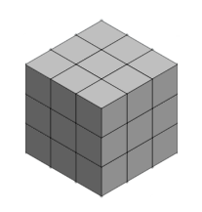

1 Thread
A workgroup of
(3x3x3) dimension
A Dispatch with (3x3x3) workgroups

Slide 14
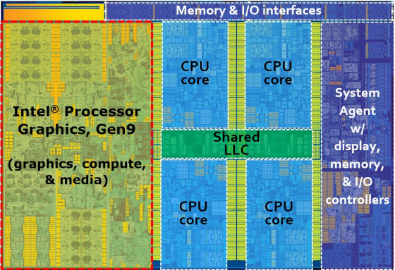
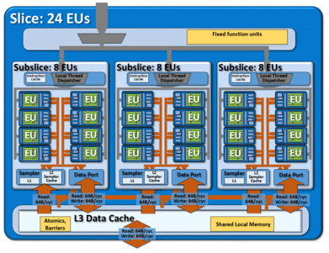
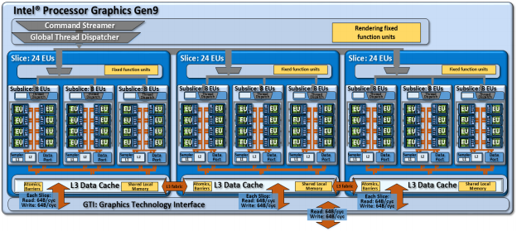
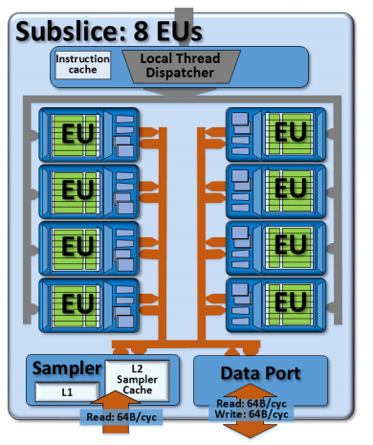
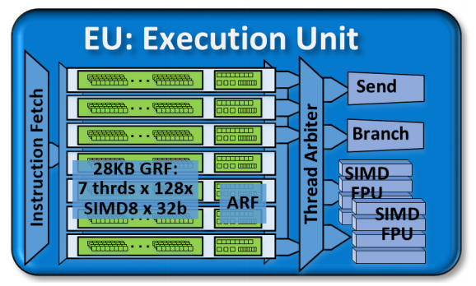

Slide 15
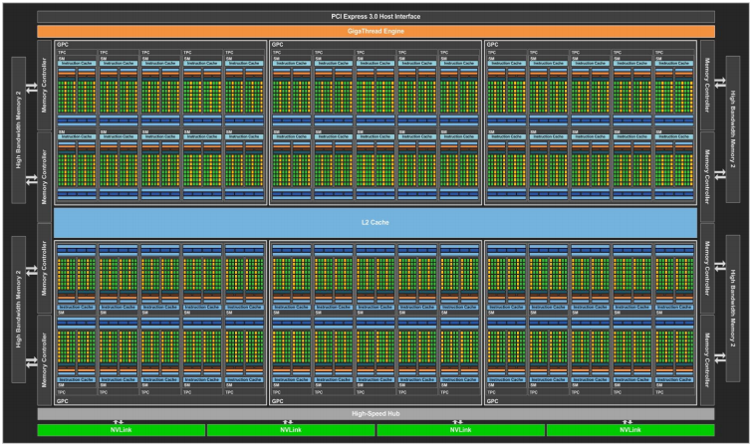
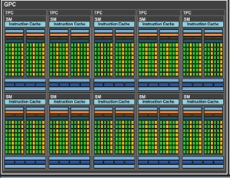
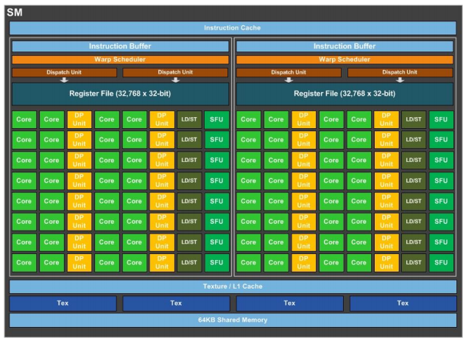
Dispatch Port
Operand Collector
FP Unit
INT Unit
Result Queue

Slide 16
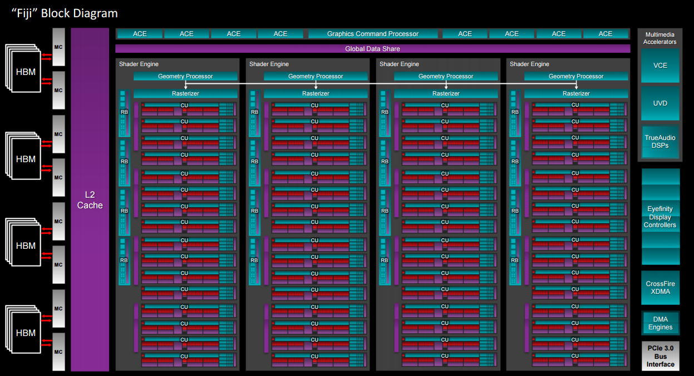
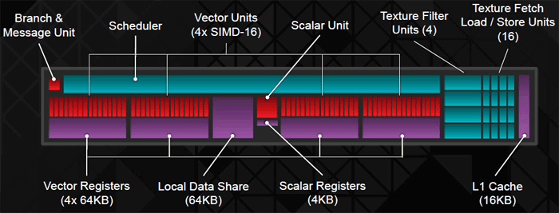

Slide 17
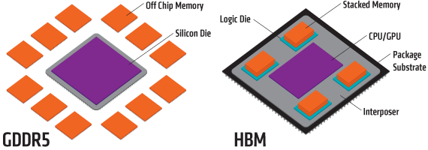
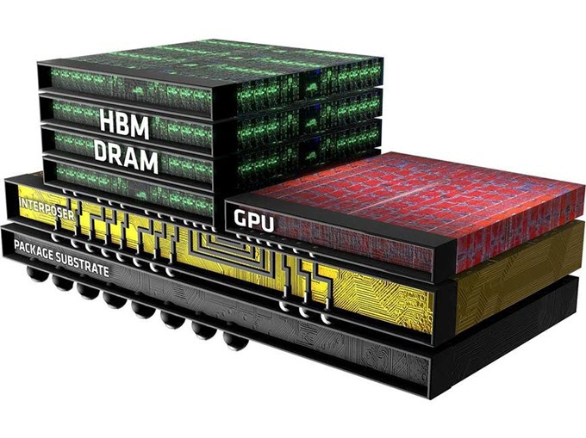

Slide 18
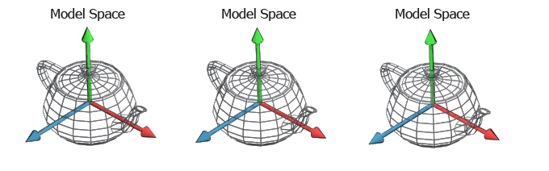
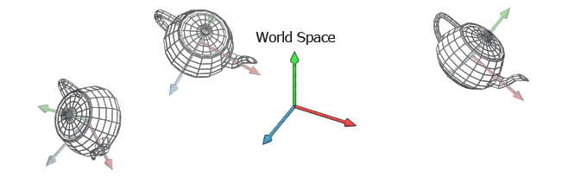

Slide 19
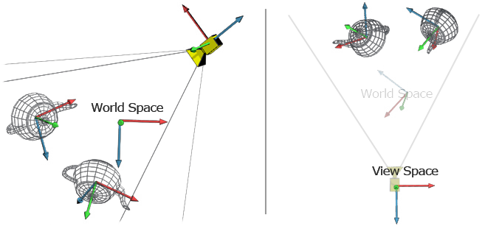

Slide 20
(640,480)
(1,1)
(-1,-1)
(0,0)

Slide 21
AND
Operation
Sprite Mask
Original Bitmap
OR
Operation
Composited Bitmap
Sprite Bitmap

Slide 22
CPU
FSB
PCI-E
Northbridge
RAM
Hi-speed
Bus
Memory
Bus
Internal
Bus
Southbridge
PCI
USB
ISA
IDE
BIOS
Legacy

Slide 23



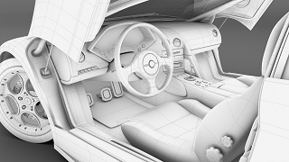
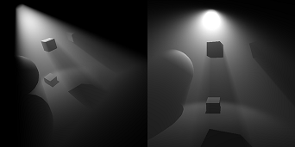
Cartoon Shading
Smoke effect
Ambient Occlusion
Fur Rendering
Shadow & light shaft

Slide 24
